Slide 1
OOPS

Slide 2
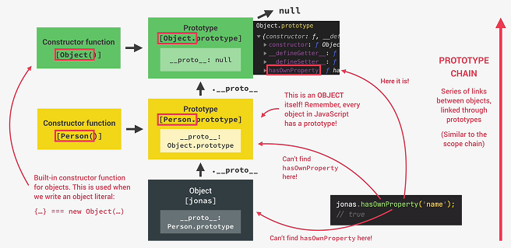
Prototype Chain

Slide 3
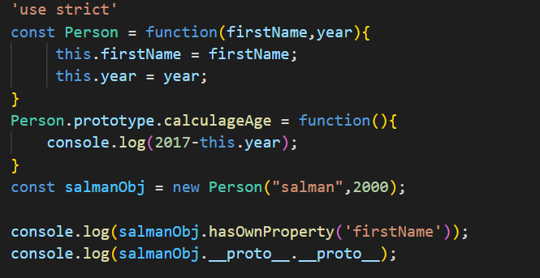
Prototypal Inheritance on Built in Objects

Slide 4
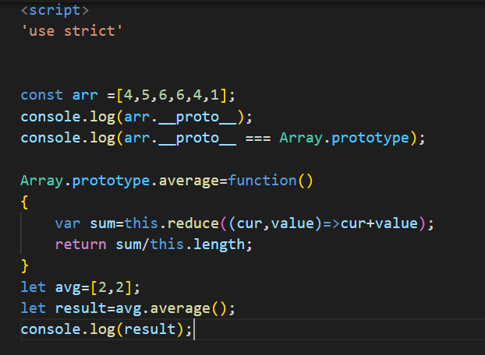
Prototypal Inheritance on Built in Objects

Slide 5
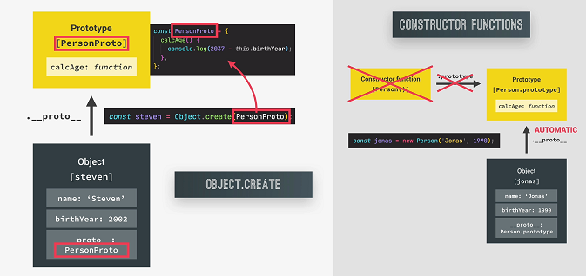
3.How Object.create Works

Slide 6
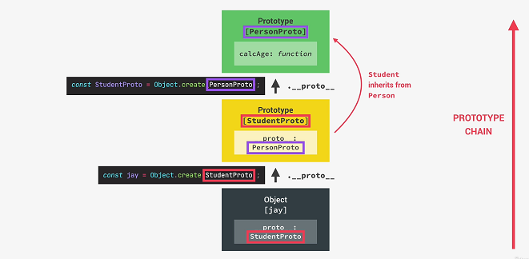
Inheritance in Object.create

Slide 7
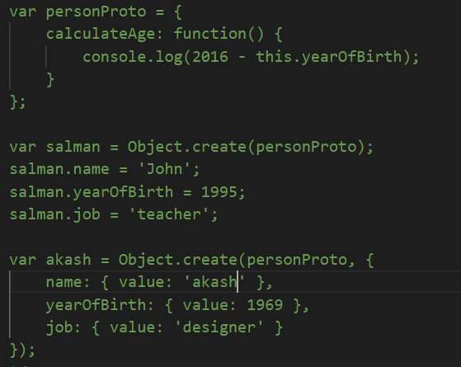
Inheritance – Object.create

Slide 8
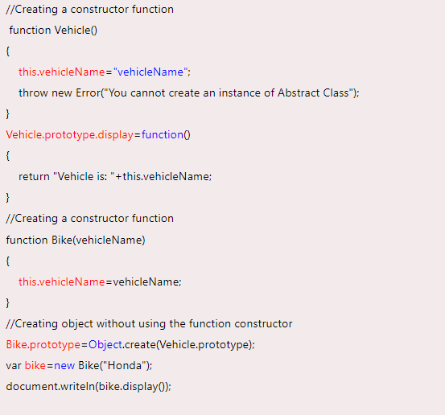
Abstraction

Slide 9
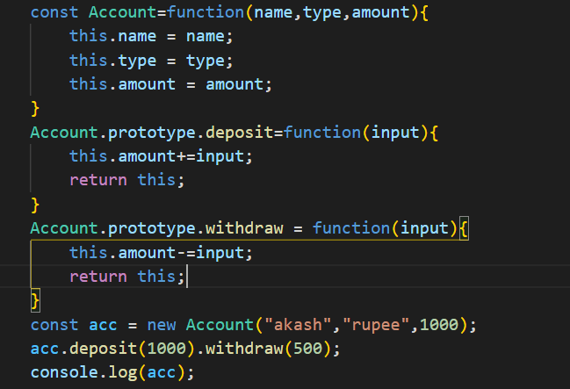
Chaining Methods

